Slide 1
CSED490U Blockchain &Cryptocurrency Assignment 2
Sajan Maharjan
thesajan@postech.ac.kr
2018.09.15

Slide 2

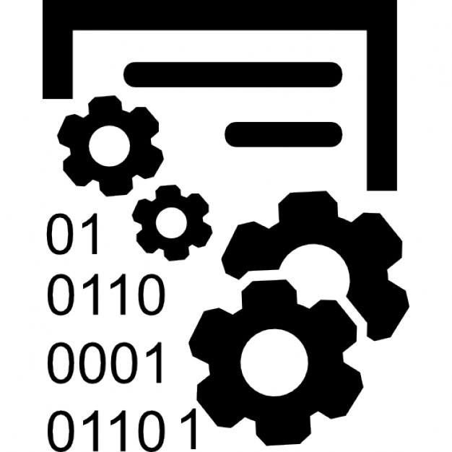
Log Management Using Blockchain
Make use of the decentralized distributed record features of Blockchain technology to keep track of logs.

Slide 3
Features
Keep track of every events and actions in the system
Maintains decentralized logs
Integrity and Tamper-Proof

Slide 4
Design & Architecture
Each node in the system will maintain copy of logs
Consensus algorithm will be used to establish a uniform copy of logs
Build on top on Ethereum technology and use PoS consensus algorithm
Owned by a single company, hence Private Blockchain

Slide 5
Resource Estimate
No. of project members required- 3
Task Division-
Interface development (Perhaps web based)
Backend development (Perhaps using Ethereum)

